Slide 1

Slide 1
Deep Value Stock Selection
Using Machine Learning
Daniel Kline
Tony Simonelli
Yang Wei

Slide 2
Slide 2
DEEP VALUE STOCK SELECTION
Data for stocks gathered using Beautiful Soup to web-scrape Yahoo Finance for stock metrics such as Price / Earnings ratio and Dividend Yields.
Data cleaning needed for outliers and N/As leaving population of about 400 stocks from the S&P 500 index. Train / Test data split to check for accuracy.
Data passed to Python process that applied K-means clustering for segmentation.
Price histories retrieved from Yahoo Finance for stocks with lowest P/Es.
Candidates for investment in Value style portfolio based on additional criteria.
Deep Value Stocks reviewed using:
Downloaded price histories for 22 stocks that evenly split into Financial and Non-Financial sectors.
Other criteria can be applied
#1
#2
#3
#4
Data cleaning involves:
Dropping stocks for missing or bad data;
Test Train split applied to data to derive measure of model accuracy.
Pandas / Python applies K-means Clustering:
Process split population into 5 clusters
Cluster #0 captured 40+ low P/E stocks,
22 Stocks with lowest P/Es selected,
Beautiful Soup applies web-scrape to grab following data:
Stock Ticker
P/E Ratio
Last Price
Dividend Yield
Volume
2

Slide 3
Slide 2
There’s Value and There’s Deep Value
Equity Valuation Metrics
Deep Value
High Growth
Standard measures include:
Price / Book Value
Price / Sales
Price / Free Cash Flow
Price / Earnings
Dividend Yield
Dividend Payout Ratio
Earnings Per Share
Value investors focus on metrics with eye for companies that are solid businesses but that may be out of favor with the market due to non-controllable factors.
P/E ratios for value stocks are below the mean for the market overall
(S&P at 17x).
Deep Value stocks will typically have P/E ratios more than 1 standard deviation below the market multiple.
Growth investors look for strong earnings growth and have little ore no interest in dividends. These stocks are typically in growth industries such as technology such as software, biotech and FANGs:
Facebook
Amazon
Netflix
Google
Equity investing can be generalized along some broad dimensions. There is passive management (index-matching) and there is active management. Within active management there is growth-oriented investing and there is value investing. The metrics used to identify stocks for each management style, as they are known, are the same: Price / Earnings Ratios and Dividend Yields are the most commonplace.
Machine Learning techniques offer new tools to identify stocks for each style.
K-means clustering offers significant potential for screening stocks.
2

Slide 4
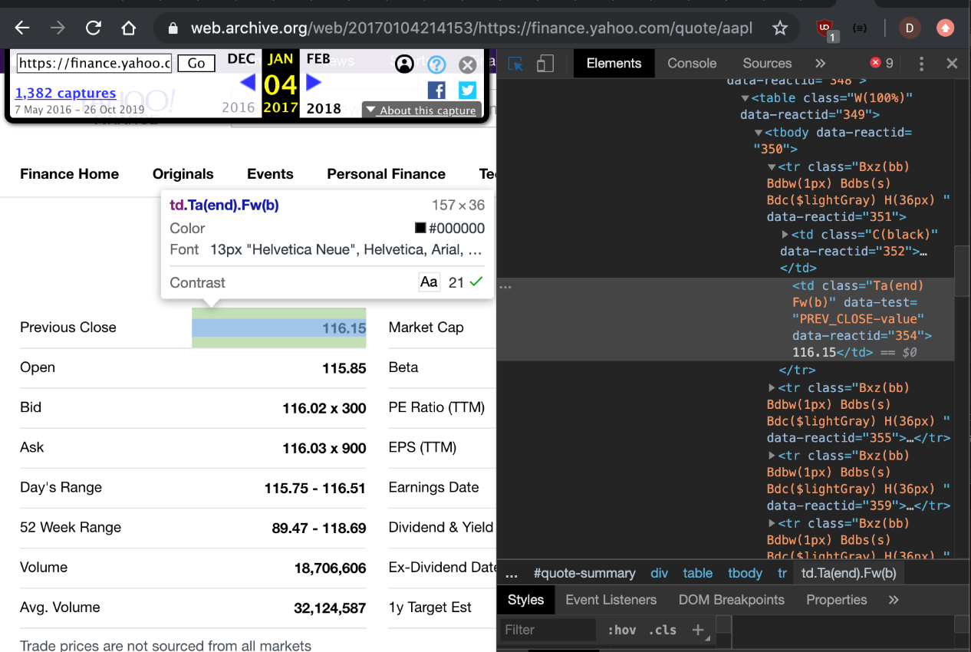
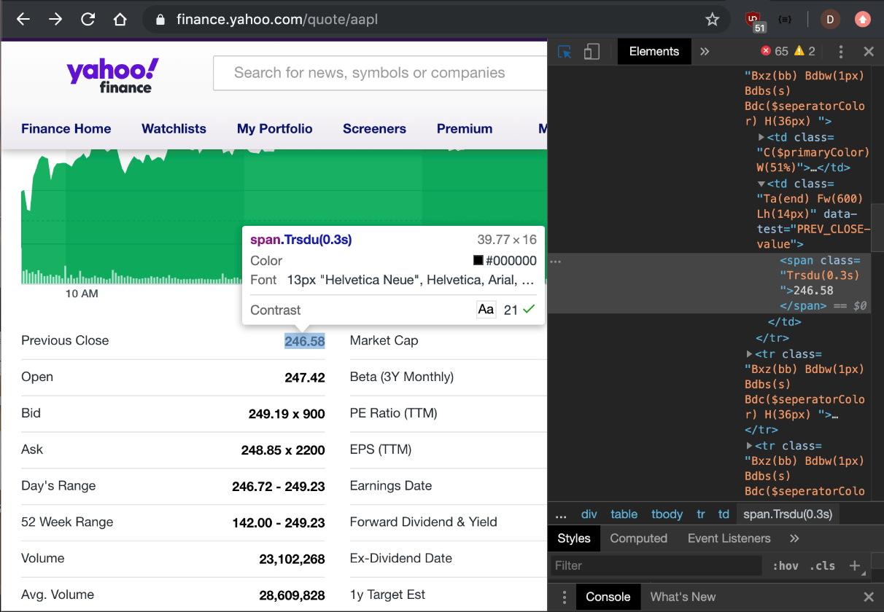
Web Scraping
2017 Data
Current Data

Slide 5
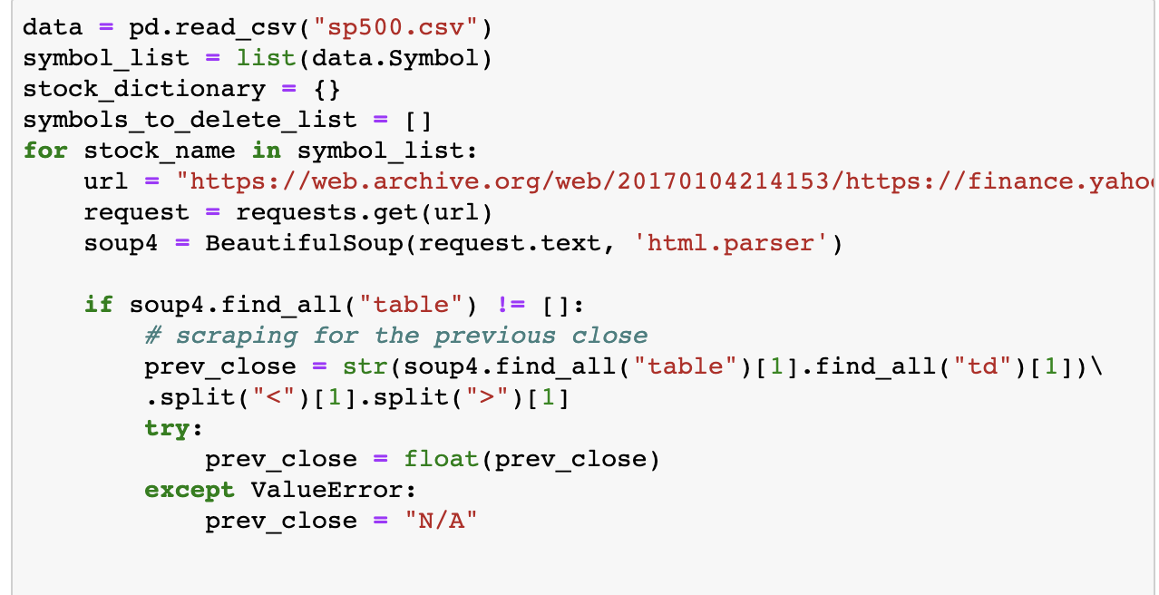
Slide 3
Beautiful Soup
e
The above code shows the first value being taken for a given stock symbol. Because we wanted certain values to be floats, we had to use Try/Except statements in case Yahoo Finance did not have a given value.
3

Slide 6
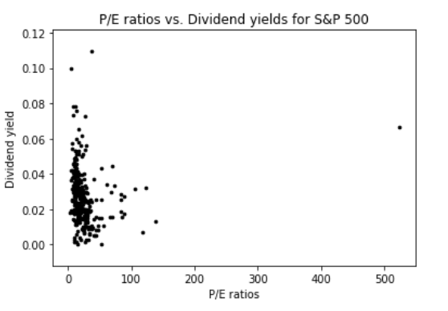
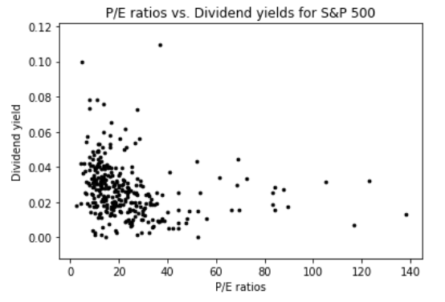
Slide 3
K-Means Clustering
e
Scikit-learn library
It features various classification, regression and clustering algorithms.
SciPy library
The SciPy library is one of the core packages that make up the SciPy stack. It provides many user-friendly
and efficient numerical routines such as routines for numerical integration, interpolation, optimization,
linear algebra and statistics.
Scatter Plot shows distribution of stocks according to P/E and Dividend Yield
3

Slide 7
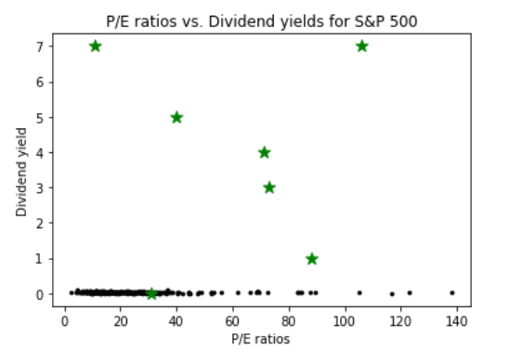
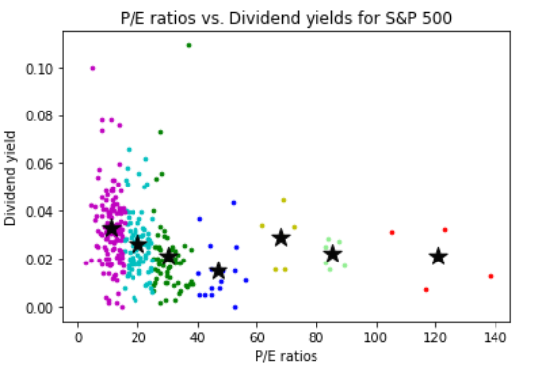
Slide 3
K-Means Clustering
e
Random points are selected as centroids, plots along with the centroids
K-means Clustering organizes the scatter plot based on groupings that identify stocks based on distances from the calculated mean of the cluster.
3

Slide 8
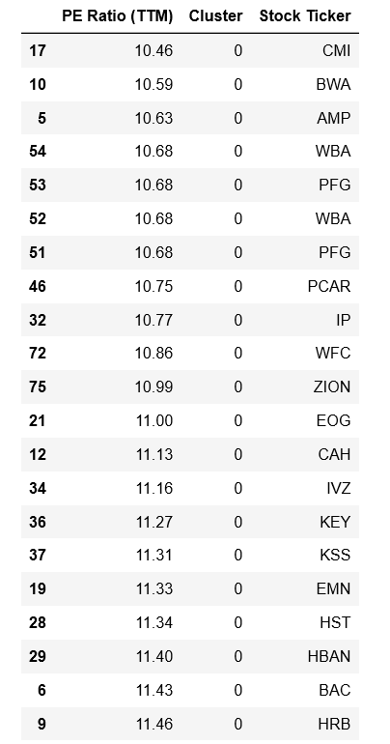
K-Means Clustering
e
Output from K-means Clustering
25 stocks in Cluster 0:
Lowest P/E ratio
Comparably high Dividend Yield

Slide 9
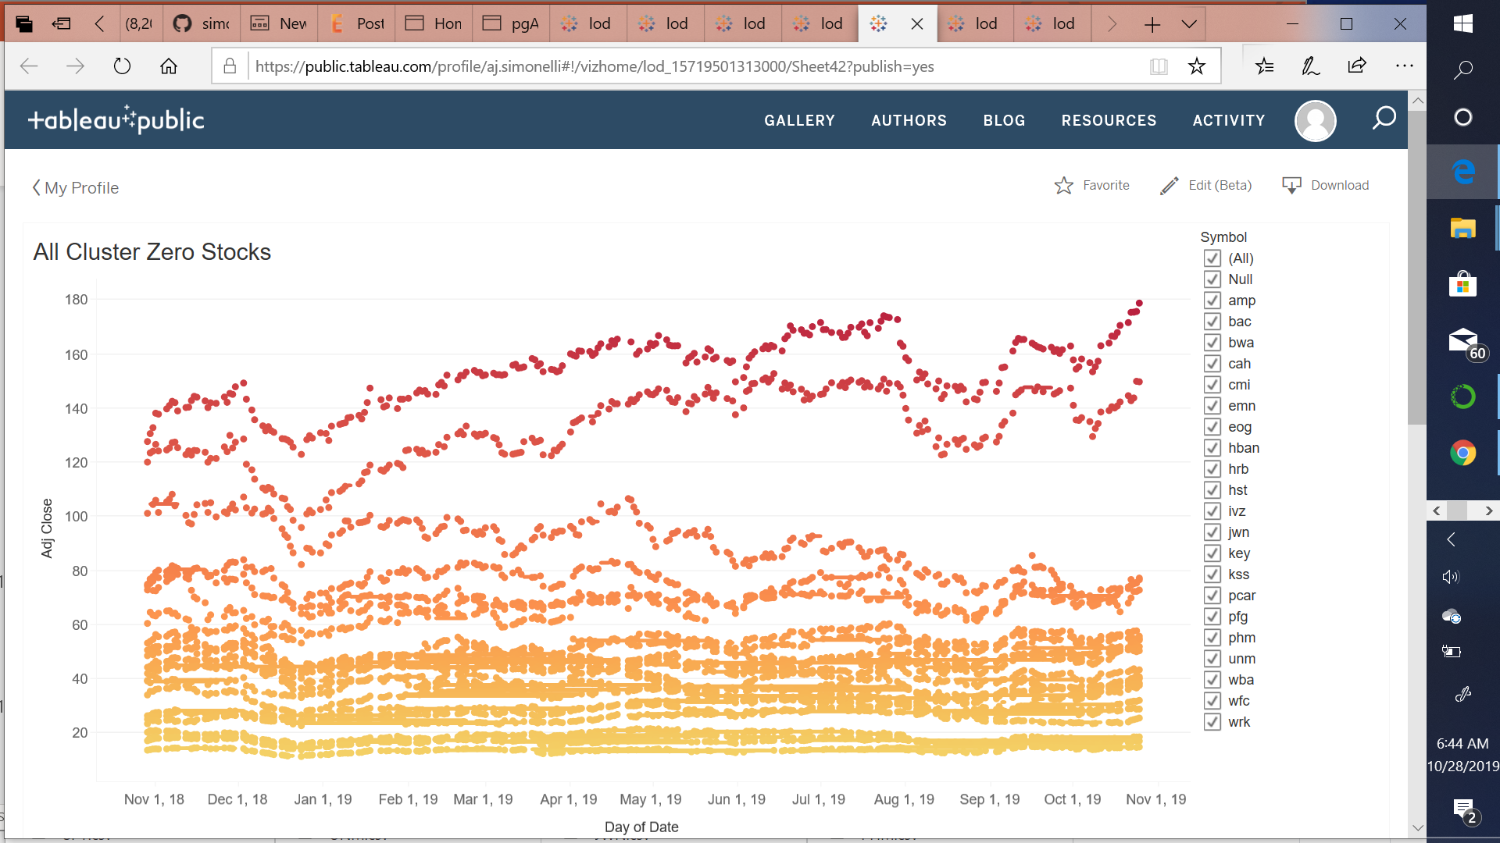
Slide 5
Tableau Charts
T
5

Slide 10
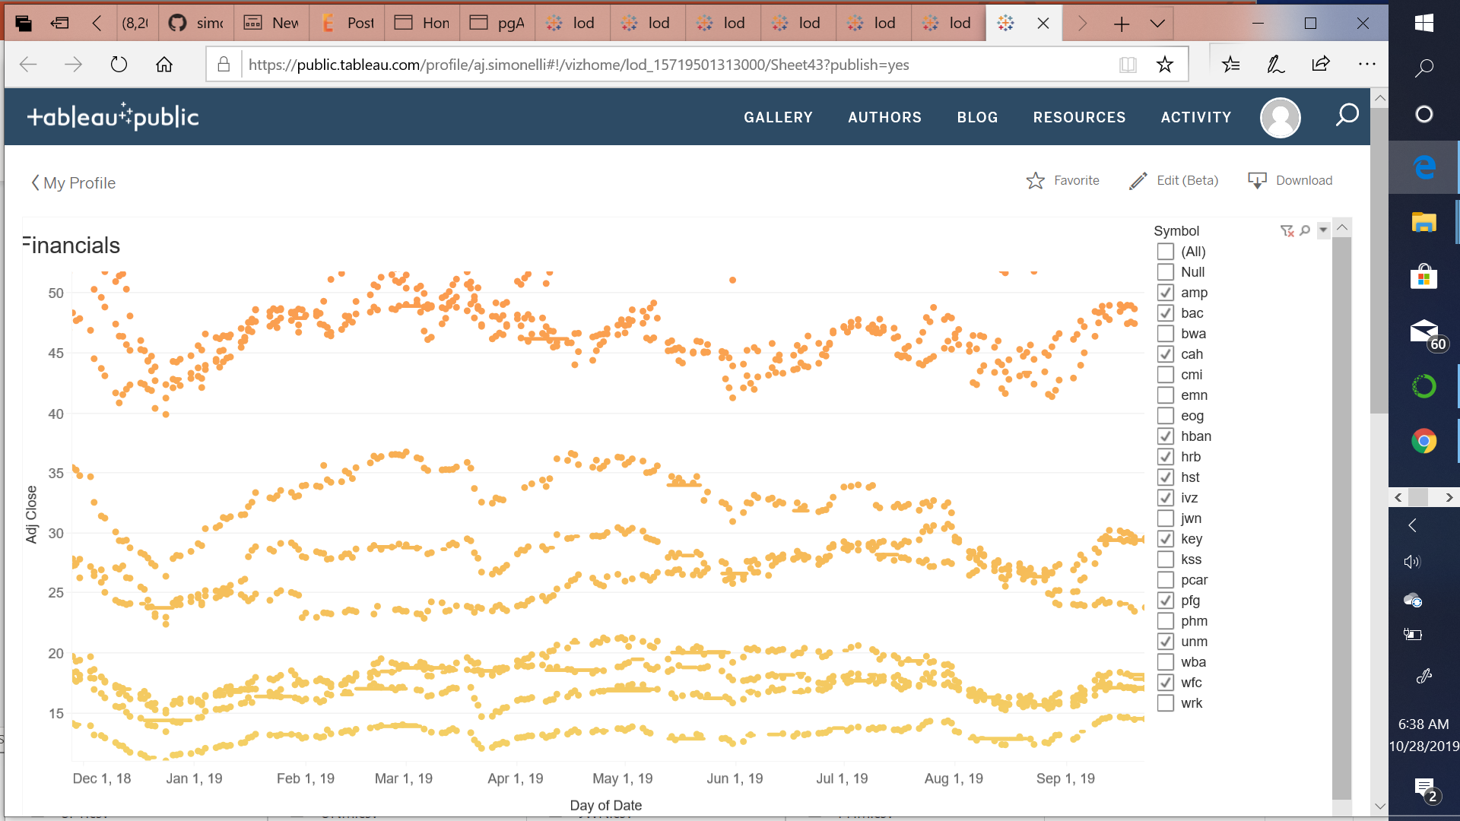
Slide 5
Tableau Charts
T
5

Slide 11
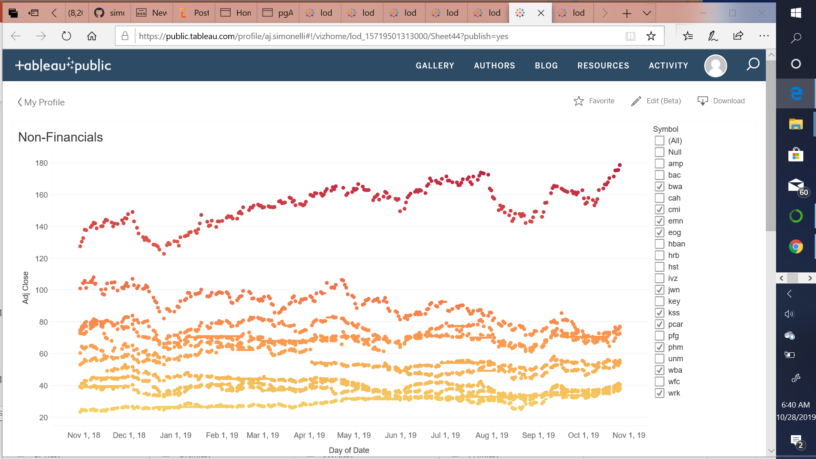
Slide 5
Tableau Charts
T
5

Slide 12
Deep Value Portfolio Selection
Financials:
Asset Managers
Ameriprise (AMP)
Invesco (IVZ)
Banks:
Bank of America (BAC)
Keybanc (KEY)
Huntington Bancshares (HBAN)
Wells Fargo (WFC)
Zion Bancshares (ZION)
Insurance:
Cardinal Health (CAH)
Principal Financial (PFG)
Services:
H&R Block (HRB)
Non-Financials:
Automotive:
Borg-Warner (BWA)
Cummins (CMI)
Paccar (PCAR)
Energy:
EOG Resources (EOG)
Hospitality:
Host Hotels and Resorts (HST)
Materials:
Eastman Chemical (EMN)
International Paper (IP)
Retail:
Walgreens (WBA)
Kohl’s (KSS)
e

Slide 13

Slide 11
THANK YOU

